Slide 1

Mini project report On Online Medical Management
Roll No. 1911985045
Name :Ashwnai Gupta
Course :CSE
Year 3
Section : 6
Batch : B.E +M.E(2019)

Slide 2
Introduction of Project :
Basically the purpose of this project is less time efficient for the patient
manual work is less or paper work is less this is web application so we can open it every where in every desktop or mobile phone…
Suppose there are two patient both are go to hospital for check up First patient is book appointment from this application and second is not so first one is go to hospital and check up and go back to our work and the second one is wait long this because he/she did not book our slot

Slide 3
Less paper work
Save time
Manual work less
Book slot of own accord
Online prescription drug

Slide 4
In Back-end used spring boot In Front-end used angular JPA hibernate for connect back with data base
Technology used
window(10) Operating System
For back-end in we used Eclipse
For data base MySQL work-bench
For check API postman
For Front-end V S code
For connectivity between spring boot backend back-end and data base I have used Hibernate through JPA.

Slide 5
E.g. @Entity , @Id
Hibernate : hibernate is ORM (Object Relational mapping)tool which used to create entries of tables in data base through some sort of annotations.

Slide 6
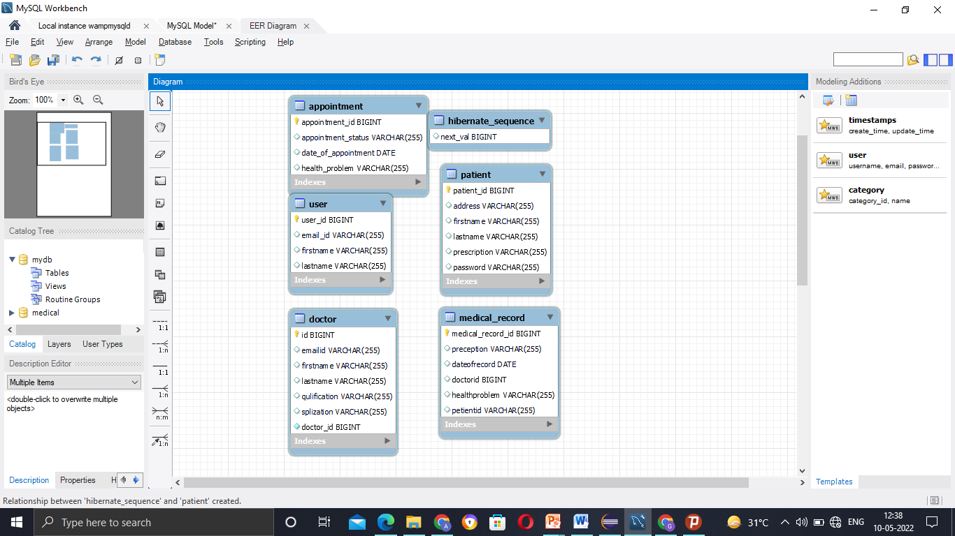
ER diagram
These are the entities which are created in the database.

Slide 7
Benefits of spring boot spring boot has a number of feature that make it a great fit for quickly developing java application
Spring Boot (Back-End)
Spring boot is an open source, microservice-based
Java web framework. The spring Boot framework create fully production-ready environment that is completely configurable using its prebuilt code within its codebase..

Slide 8
User | Doctor | Appointment | medicalrecord | patient
userid | doctorid | appointmentId | medicalrecordid | patientid
first name | First name | Health problem | Patient id | firstname
last name | Last name | appointmentstatus | doctorId | lastname
emailId | emailId | dateOfAppointment | preception | Password
password | password |  | healthproblem | address
 | qualifications |  | dateofrecord | prescription
 | specialization

Slide 9

My SQL DATABASE:
MySQL is an open-source relation database management system. its most popular database management system software used for managing the relational database

Slide 10

Front-end (Angular)
Angular is an application design framework and development platform for creating single page application using HTML and typescript.

Slide 11

Postman
Postman is an API (Application programming interface) used for API testing. It is http client that tests http request

Slide 12
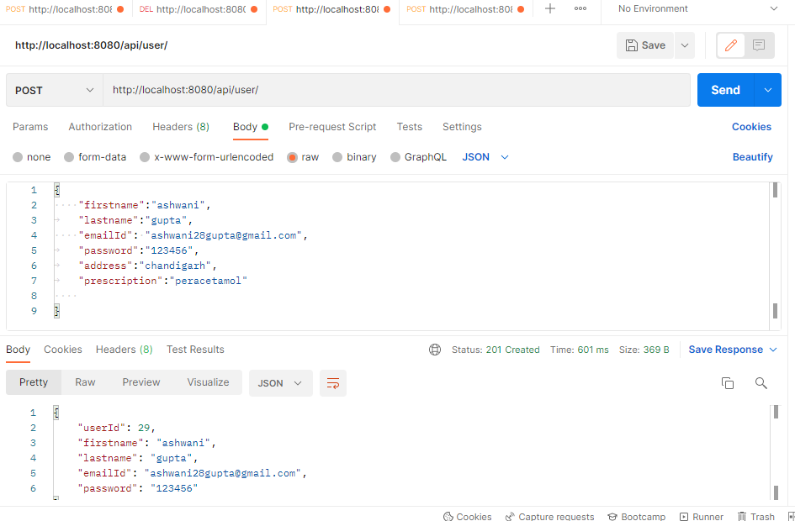
Postman value screen short

Slide 13
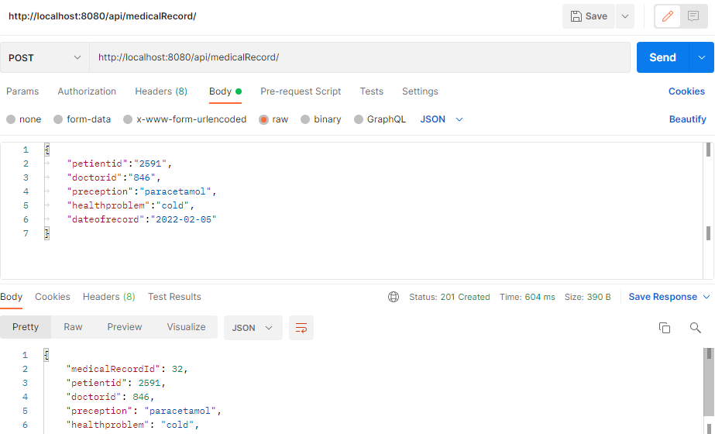
postman

Slide 14
Annotation
@RestController
@RequestMapping
@Autowired
@GetMapping
@PostMapping
@PathVariable
@Entity
@Id
@GeneratedValue
@Override
@Service

Slide 15
@Entity
The entities are the persistence objects stores as a record in the database.
Autowired
In the spring boot, @Autowired annotation is used for dependency injection.

Slide 16
Future Scope
I will payment method in the project after get appointment..
Adding email service when appointment get confirm mail will send to the patient email address..
Adding some health tips in form of video or photo..
general perception for common diseases like cold and fever..
First aid video in common emergency conditions..

Slide 17
Conclusion
My project is not completed due to lack of time but I will keep on adding new functionalities in this project in future..

Slide 18


